Slide 1

Donation & Fundraising Database System
CS630 – Database Systems
Presented by: Chaimaa Mallas
Date: December 2025

Slide 2






Project Overview
Platform
Connects donors, organizers, and beneficiaries.
Tracking
Tracks campaigns, donations, and fund disbursement.
Technology
Built using Oracle SQL with complete ERD and schema.
Components
Includes sample data and queries for demonstration.

Slide 3





Problem Statement
Transparency
Need for transparent donation tracking.
Trust
Donors struggle to trust fund usage.
Organization
Organizers need a structured system.
Reliability
Beneficiaries need reliable fund transfers.

Slide 4





Project Goals
Database Design
Design a normalized relational database.
Workflow Representation
Represent real-world donation workflows.
Data Consistency
Ensure consistency using PK/FK relationships.
Demonstration
Provide sample data and example queries.

Slide 5
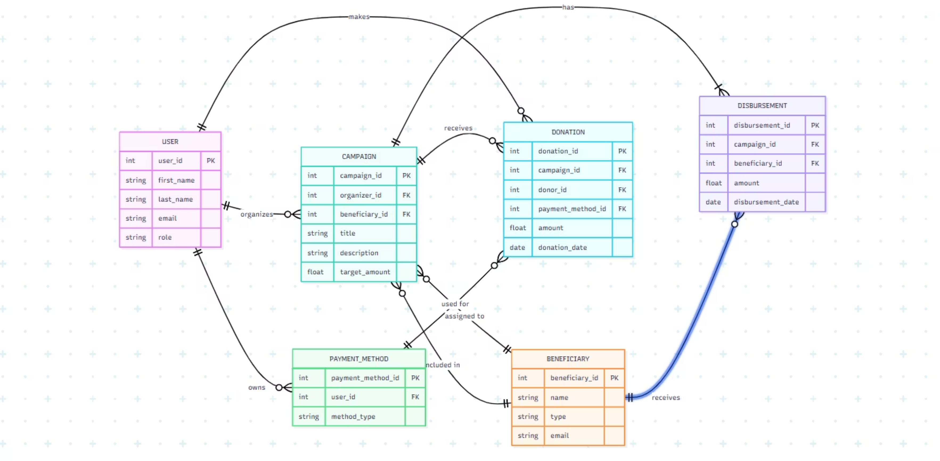
ERD Diagram
Untitled diagram | Mermaid Chart
This diagram illustrates the core entities and their relationships within the donation system.

Slide 6






Main Entities
Users
Beneficiary
Donors and organizers.
Individuals or nonprofits.
Campaign
Payment Method
Fundraising goals and descriptions.
Donor payment information.
Donation
Disbursement
Financial contributions.
Money released to beneficiaries.

Slide 7
Database Design Choices
Normalization
Relationships
Data Types
Normalized to 3NF for efficiency.
Clear PK/FK relationships for integrity.
Amount fields use NUMBER(12,2).
Separation
Simplicity
Separate tables for donations vs. disbursements.
Simple structure for readability and demonstration.

Slide 8
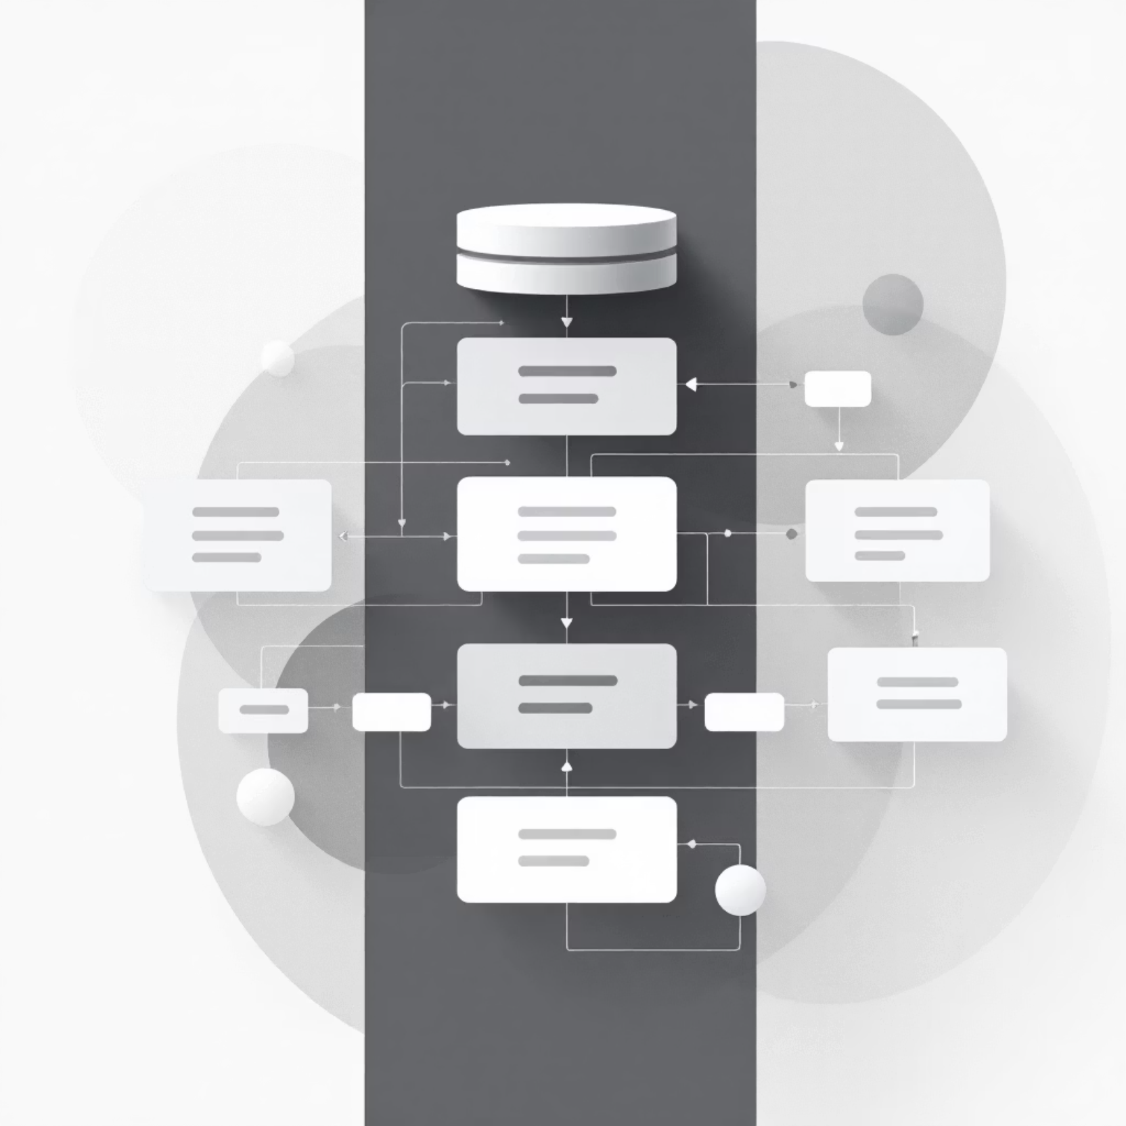
Schema Overview
Key Structure Decisions
users(user_id, first_name, last_name, role)
campaign(organizer_id → users)
donation(donor_id → users)
disbursement(beneficiary_id → beneficiary)
These relationships ensure data integrity and reflect real-world interactions.

Slide 9
Sample Data Example
3
2
2
2
Users
Beneficiaries
Campaigns
Payment Methods
Donors and organizers.
Individuals or nonprofits.
Fundraising goals.
Donor payment info.
2
2
Donations
Disbursements
Financial contributions.
Money released.
Sample data was used to thoroughly test the system's functionality and validate relationships.

Slide 10
Example SQL Queries
01
02
SELECT
INSERT
Retrieve specific data.
Add new records.
03
04
UPDATE
DELETE
Modify existing data.
Remove records.
05
06
TRUNCATE
JOIN
Clear table data.
Combine data from multiple tables.
These queries validate the system's integrity and demonstrate its operational capabilities.

